Slide 1
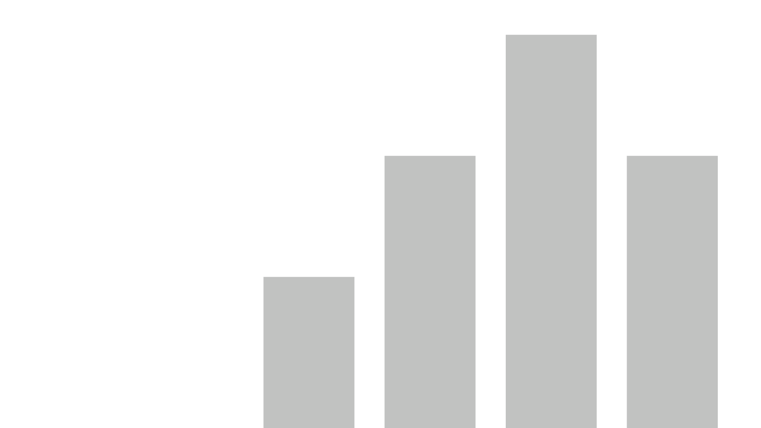


SalesDashboard_Production
View in Power BI
Last data refresh:
2/16/2021 11:32:08 AM Central Standard Time
Downloaded at:
2/16/2021 11:34:37 AM Central Standard Time

Slide 2
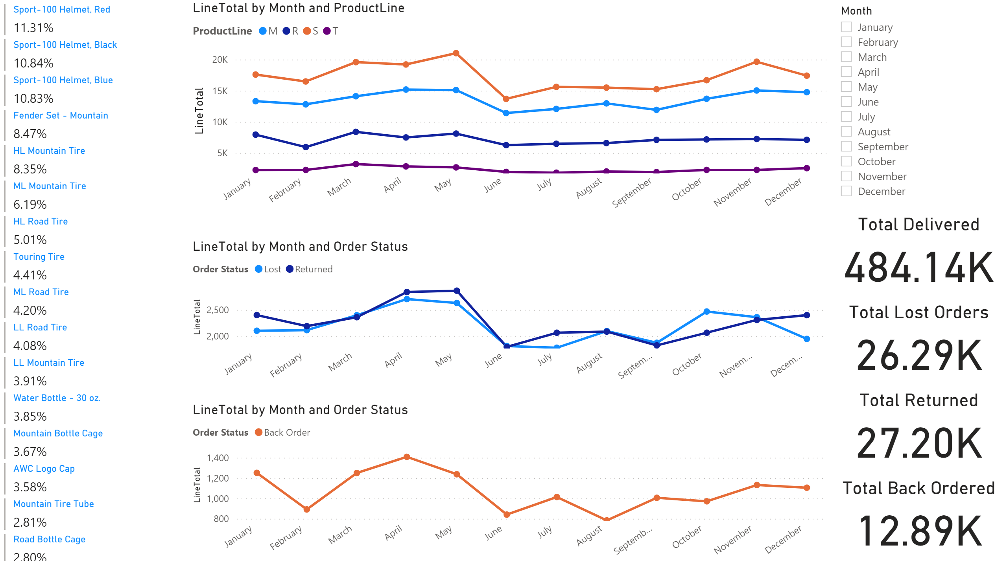
Sales Dashboard

Slide 3
Sales Dashboard
You can filter for each month, or hold ctrl for multiple months

Slide 4
Sales Dashboard
This will sort to the highest number based on filters applied.

Slide 5
Sales Dashboard

